Slide 1
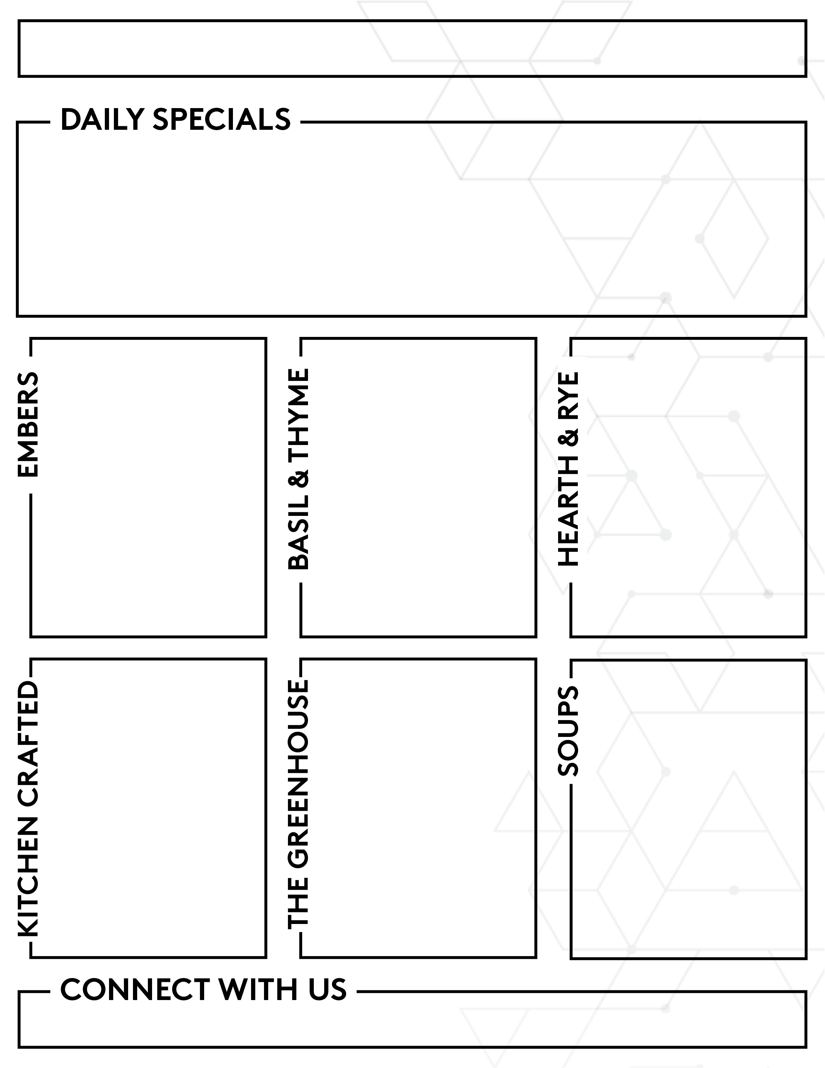


Wk. 5
09/28 to 10/02
Wk. 2
weekly special | mediterranean chicken shawarma
monday onion rings
tuesday baja fish taco
wednesday crab rangoon
thursday nashville hot chicken
friday grown up grilled cheese
BREAKFAST SPECIALS
KITCHEN CRAFTED country ham | EMBERS chicken & waffles
weekly soup tomato basil | monday broc. cheddar
tuesday potato soup | wednesday corn chowder
thursday white chix chili | friday: lemon orzo
BASIL & THYME
weekly special | mediterranean chicken shawarma
monday mac & cheese bites
tuesday jalapeno poppers
wednesday crab rangoon
thursday pretzel bites
friday fried pickles
pizza | farm truck
entrée | chicken parm piadini
bread | garlic bread
SANDWICH OF THE WEEK Lemon Rosemary Turkey turkey, swiss, lettuce, tomato, lemon rosemary mayo, focaccia
power bowl| asian shrimp + noodle
protein bites| tuna salad
fresh fruit | strawberries
dessert | strawberry shortcake
snack | lemon luau parfait
GRAB + GO
power bowl| chicken caesar salad
protein bites| tuna salad
fresh fruit | strawberries
dessert | assorted donuts
snack | lemon luau parfait
chimichurri steak mediterranean chix
baja fish chicken tinga
fried chicken rotisserie chicken
buffalo chicken pulled pork
beef lasagna chicken marsala
basmati rice | farro risotto black beans | garlic broccoli baklava
cilantro lime rice | spanish rice zucchini & onion | fire roasted corn queso | tres leches
mash potato| hashbrown casserole collard greens | corn pudding pecan pie
sauce: smoked gouda | pimento veg: brussels sprouts | broccoli mushrooms | peppers & onion mini s’mores pie
lemon orzo | Italian pea & mushroom giardiniera veg | asparagus tips tiramisu
KETTLE CHIP OF THE WEEK
dill pickle
ranch
ENTRÉE
SIDES
monday honest bowl
tuesday verde
wednesday happy hen
thursday cheese louise
friday tavola italiana
chimichurri steak mediterranean chix
pork carnitas chicken tinga
fried chicken rotisserie chicken
buffalo chicken pulled pork
beef lasagna chicken marsala
basmati rice | farro risotto black beans | garlic broccoli baklava
cilantro lime rice | spanish rice zucchini & onion | fire roasted corn queso | maple churro cookies
mash potato| hashbrown casserole collard greens | corn pudding fried cheesecake
sauce: smoked gouda | pimento veg: brussels sprouts | broccoli mushrooms | peppers & onion pumpkin spice cookies
lemon orzo | Italian pea & mushroom giardiniera veg | asparagus tips crème brulee bites
weekly soup tomato basil | monday broc. cheddar
tuesday potato soup | wednesday zuppa toscano
thursday white chix chili | friday: lemon orzo
SALAD BAR THEME socal
Executive Chef, Chris Peeler | 704.384.8940
Associate Director, Corey Thacker | 704.384.4644
Notes:
Week 4 – No pizza station

Slide 2

Wk. 5
09/28 to 10/02
Wk. 2
MIDDLE BAR
TOPPINGS + SIDES
hummus pita chips green onion diced tomato green olives feta cheese
TOPPINGS + SIDES
lettuce pico de gallo salsa rojo queso fresco cheddar cheese lime wedges sour cream
TOPPINGS + SIDES
coleslaw potato salad pasta salad ambrosia
monday
tuesday
wednesday
SMOOTHIE BAR
made to order smoothies 11am-2:30pm
SMOOTHIE BAR
made to order smoothies 11am-2:30pm
SMOOTHIE BAR
made to order smoothies 11am-2:30pm
TOPPINGS + SIDES
bacon bits green onion jalapeno cheddar cheese bbq drizzle ranch drizzle
TOPPINGS + SIDES
parmesan cheese crushed red pepper fresh basil lemon wedge mama’s blessing
thursday
friday
SMOOTHIE BAR
made to order smoothies 11am-2:30pm
SMOOTHIE BAR
made to order smoothies 11am-2:30pm
Executive Chef, Chris Peeler | 704.384.8940
Associate Director, Corey Thacker | 704.384.4644
Notes:
Week 4 – No pizza station

Slide 3
Wk. 6
10/05 to 10/09
Wk. 2
BREAKFAST SPECIALS
KITCHEN CRAFTED livermush | EMBERS juevos rancheros
BASIL & THYME
weekly special | french dip
monday onion rings
tuesday chicken fajitas (2)
wednesday grown up grilled cheese
thursday smash burger
friday pretzel bites + cheese sauce
pizza | white chicken alfredo
entrée | garlic shrimp scampi
bread | focaccia + spinach dip
SANDWICH OF THE WEEK ITALIAN PANINI ham, pepperoni, salami, provolone, roasted red peppers, pesto mayo, arugula
GRAB + GO
power bowl| buffalo chicken + grain
protein bites| lemon basil chix salad
fresh fruit | pineapple
dessert | chocolate chip cannoli
snack | cucumber crunch salad
KETTLE CHIP OF THE WEEK
garlic + herb
ranch
ENTRÉE
SIDES
monday &okra
tuesday verde
wednesday kazan
thursday tandoori
friday oktoberfest
pot roast smothered pork chop
taco beef tomatillo chicken
teriyaki chicken hibachi steak
butter chicken salmon + coconut sauce
pork schnitzel grilled brats
rosemary polenta | mash potatoes roasted carrot| green beans blueberry cobbler
cilantro lime rice | spanish rice peppers & onions| charro beans queso | churro
fried rice | lo mein | spring roll veg blend | sweet carrots cinnamon xangos
bombay potato | basmati rice garlic chili broccoli | roasted veg. island mango cheesecake
potato pancake | braised cabbage butter dill carrots | bacon brussels german chocolate cake
weekly soup lemon orzo | monday broc. cheddar
tuesday minestrone | wednesday tomato
thursday white chix chili | friday: potato soup
SALAD BAR THEME SMOKEHOUSE
Executive Chef, Chris Peeler | 704.384.8940
Associate Director, Corey Thacker | 704.384.4644
Notes:
Week 4 – No pizza station

Slide 4
Wk. 5
10/05 to 10/09
Wk. 2
MIDDLE BAR
TOPPINGS + SIDES
potato salad pasta salad fresh fruit coleslaw
TOPPINGS + SIDES
lettuce pico de gallo salsa rojo queso fresco cheddar cheese lime wedges sour cream
TOPPINGS + SIDES
yum yum sauce ginger sauce soy sauce lemon wedges green onion
monday
tuesday
wednesday
SMOOTHIE BAR
made to order smoothies 11am-2:30pm
SMOOTHIE BAR
made to order smoothies 11am-2:30pm
SMOOTHIE BAR
made to order smoothies 11am-2:30pm
TOPPINGS + SIDES
bacon bits green onion jalapeno cheddar cheese bbq drizzle ranch drizzle
TOPPINGS + SIDES
parmesan cheese crushed red pepper fresh basil lemon wedge mama’s blessing
thursday
friday
SMOOTHIE BAR
made to order smoothies 11am-2:30pm
SMOOTHIE BAR
made to order smoothies 11am-2:30pm
Executive Chef, Chris Peeler | 704.384.8940
Associate Director, Corey Thacker | 704.384.4644
Notes:
Week 4 – No pizza station

Slide 5
Wk. 2
SALAD BAR THEME
08/31 to 09/04
09/07 to 09/11
09/14 to 09/18
FIESTA
Guacamole | Lime
Black Beans | Peppers
Chili Crisp Ranch | Roasted Corn
Cilantro | Tortilla Chips
Green Onion | Salsa
Jalapeno | Cornbread
CIAO
Marinated Artichokes | Roma Tomato
Black Olives | Croutons
Fresh Mozzarella | Red Onion
Orzo | Salami
Parmesan | Garlic Knots
Pepperoncini | Sun Dried Tomato Vinaigrette
Pan Pacific
Carrots | Peanuts
Celery | Peppers
Crispy Wonton | Tofu
Daikon | Citrus Vinaigrette
Edamame | Water Chestnuts
Green Onion | Foccacia
Week 1
Week 2
Week 3
Week 2
09/21 to 09/25
09/28 to 10/02
10/05 to 10/09
GREEK OUT
Marinated Artichokes | Grilled Pita
Fresh Oregano | Kalamata Olives
Cucumbers | Pepperoncini
Crumbled Feta | Red Onion
Green Olives | Tomatoes
Green Onion | Green Goddess
SOCAL
Avocado | grilled pita
goat cheese | black beans
grilled pita
white beans
almonds
roasted corn
SMOKEHOUSE
roasted corn | cucumber
crispy onions | tomato
cowboy caviar | red onion
coleslaw | roasted red pepper
smoked chicken | chipotle ranch
black beans
Week 5
Week 6
Executive Chef, Chris Peeler | 704.384.8940
Associate Director, Corey Thacker | 704.384.4644
Notes:
Week 4 – No pizza station

Slide 6
Wk. 2
LATE NIGHT EXCLUSIVES 5pm-2am
08/31 to 09/04
09/07 to 09/11
09/14 to 09/18
EMBERS
FIT greek chicken pita BYO QUESADILLA chicken | steak Appetizer fried cheesecake
EMBERS
FIT grilled steak bites Special mac + cheese bites Appetizer jalapeno poppers
EMBERS
FIT grilled chicken tenders Special byo grilled cheese Appetizer chicken flautas
week 1
week 2
week 3
09/21 to 09/25
09/28 to 10/02
10/05 to 10/09
EMBERS
FIT grilled shrimp Special philly cheese steak Appetizer egg roll + duck sauce
EMBERS
FIT baked chicken wings Special signature fried wings Appetizer fried pickles + ranch
EMBERS
FIT grilled salmon + wild rice bowl Special ham + cheese sliders Appetizer spinach dip + foccacia
week 4
week 5
week 6
Executive Chef, Chris Peeler | 704.384.8940
Associate Director, Corey Thacker | 704.384.4644
Notes:
Week 4 – No pizza station

Slide 7



Wk. 2
Action Stations 11am-2:30pm
10/07
09/09
09/23
Asian Bowl
Shrimp + Grits
Caesar Salad
choose a base
lo mein
jasmine rice
pick a protein
chicken thigh
skirt steak
jumbo shrimp
grilled chicken or steak
cherry tomato
red onion
black olives
parmesan cheese
cheddar cheese
cucumbers
croutons
house made Caesar dressing
jumbo grilled shrimp
andouille sausage
bacon
red onion
bell pepper
gouda grits
zen
creole queen
the greenhouse
sauce it
hoisin
soy sauce
top it
green onion
green peppers
broccoli
onion yum yum sauce
egg roll
+$2.00
cheddar bay biscuit
+$1.00
Oscar Giraldo
Rebecca Alvarado
Shondaysia McCoy
Executive Chef, Chris Peeler | 704.384.8940
Associate Director, Corey Thacker | 704.384.4644
Notes:
Week 4 – No pizza station

Slide 8
Wk. 2
GRAB + GO
Always Available
chicken salad + naan + veggies
fruit + cheese box
hard boiled eggs
chocolate oreo parfait
dijon roasted potato salad
classic tuna salad
cajun farmer’s pasta salad
greek pasta salad
blt pasta salad
lemon basil chicken salad
broccoli bacon salad
thai cucumber salad
citrus lentil grilled salmon
quinoa cobb salad
buffalo chicken farro
southwest wild rice + blackbean
mediterranean power bowl
core menu
power bowls
composed salad
Rotating Items
power bowl
overnight oats
composed salad
fresh fruit
dessert
fresh mixed fruit
pineapple cup
mixed berries
strawberries
mixed grapes
strawberry shortcake parfait
banana pudding parfait
tiramisu
chocolate chip cannoli
lemon luau parfait
peaches + cream shortcake
berries + cream
chia mango parfait
blueberry crunch
tropical fruit
carrot cake
chocolate banana
coconut
chocolate peanut butter
fresh fruit
desserts
overnight oats
Executive Chef, Chris Peeler | 704.384.8940
Associate Director, Corey Thacker | 704.384.4644
Notes:
Week 4 – No pizza station

Slide 9
Wk. 5
Wk. 2
Weekly Menu 9/28 to 10/2
BREAKFAST
7am-9:30am
oatmeal | grits
scrambled eggs | cheese eggs
turkey sausage | pork bacon
BREAKFAST
7am-9:30am
oatmeal | grits
scrambled eggs | cheese eggs
turkey sausage | pork bacon
BREAKFAST
7am-9:30am
oatmeal | grits
scrambled eggs | cheese eggs
turkey sausage | pork bacon
monday
tuesday
wednesday
LUNCH
11am-2pm
mediterranean chicken
basmati rice
black beans
garlic broccoli
broccoli cheddar soup
LUNCH
11am-2pm
chicken tinga
cilantro lime rice
fire roasted corn
zucchini & onion
potato soup
LUNCH
11am-2pm
rotisserie chicken quarter
collard greens
corn pudding
mashed potatoes
zuppa toscano
BREAKFAST
7am-9:30am
oatmeal | grits
scrambled eggs | cheese eggs
turkey sausage | pork bacon
BREAKFAST
7am-9:30am
oatmeal | grits
scrambled eggs | cheese eggs
turkey sausage | pork bacon
thursday
LUNCH
11am-2pm
buffalo chicken
mac & cheese
brussels sprouts
broccoli
tomato soup
friday
LUNCH
11am-2pm
chicken marsala
lemon orzo
giardiniera vegetables
Italian peas & mushrooms
lemon orzo soup
Notes:
Week 4 – No pizza station

